Slide 1
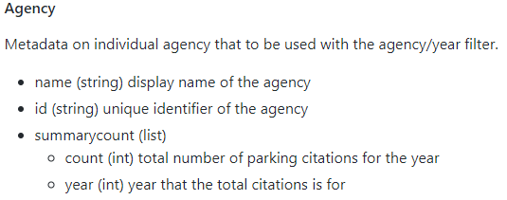
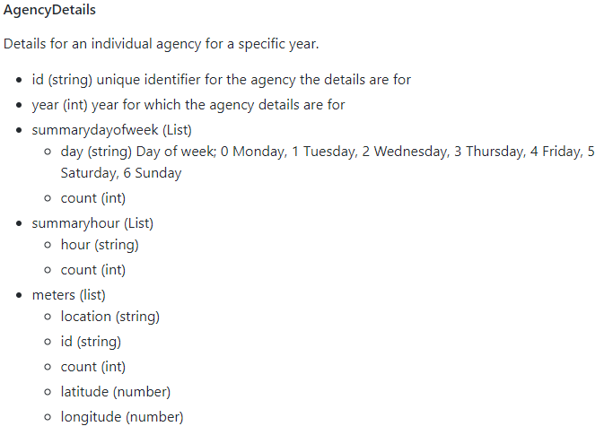
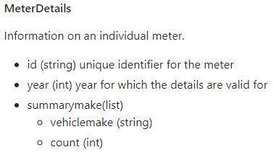
DTO’s: Data transfer Object diagram:

Slide 2
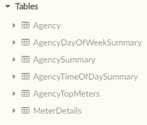
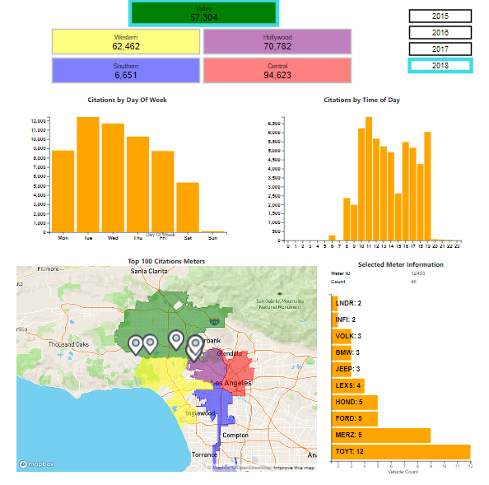
Endpoints
SQLite DB
Flask App
Visualization
REST End Points
Agency: region id, summary counts by year
AgencyDetails: region id, year, summarized counts by day of week, hour of day, and meter list
MeterDetails: meter id, year, summary count by vehicle make

Slide 3
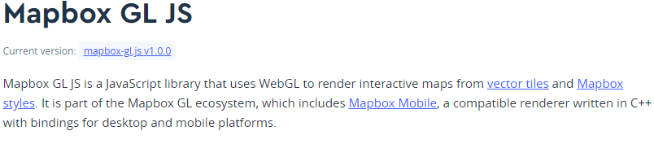

MAP
GeoJSON for District Boundaries
Mapbox GL Library:
Uses vector tiles
Concise syntax
Begins as “map” object
“map” object exposes methods to add markers, fire events, etc.
GeoJSON:
Polygon boundaries of DOT districts

